Slide 1
RAYALASEEMA UNIVERSITY SRI SANKARA’S DEGREE COLLEGE, KURNOOL
D rajesh
Bsc.MICROBIOLOGY
21367008003

Slide 2
Project Title : Driven Information Gathering and Threat Intrelligence
Team id : LTVIP2024TMID14080
Team size : 05
Team leader : Akthar Shaik shavali
Team member : Boggula Mani kumar
Team member : Darur Rajesh
Team member : Gollakatikala Manohar
Team member : kalagondla Yella raju

Slide 3
INDEX
SNO. TOPIC NAME PAGE NO.
1. Osnit frame work into key points - 5
2. Osnit frame work on the tools for
Dns information gathering - 6
3. Dns for mapping source for ruk website
Details analysis - 7
4. Ruk website details report for tools - 8
5. Srv details and txt for records on the
ruk website - 9
6. Osnit frame work analysis - 10
7. Information source intelligence - 11
8. Ibooma website details analysis web
checker and them analysis - 12
9. Tls security for issueses site feature - 13
10. Website into web checker.com target
domain 1tamil.mv - 14,15
Notes:
Project title: Driven information gath
ring threat i8ntellegence

Slide 4
Driven information gathering threat and intelligence
When we use osnit frame work on use service threat intelligence

Slide 5
Osnit frame work into source key points
It seems like you're referring to the OSSTMM (Open Source Security Testing Methodology Manual) framework. Here are some key points about the OSSTMM framework:
Comprehensive Methodology: OSSTMM is a comprehensive framework for security testing, providing guidelines, techniques, and methodologies for assessing the security posture of systems, networks, and applications.
Open Source: As the name suggests, OSSTMM is an open-source framework, which means it is freely available for anyone to use, modify, and distribute.
Risk-Based Approach: OSSTMM emphasizes a risk-based approach to security testing, focusing on identifying and prioritizing security risks based on their potential impact on the organization.
Seven Sections: The OSSTMM framework is organized into seven main sections:
Information Security Foundation
Information Security Testing
Security Operations
Legalities
Data Destruction
Social Engineering
Tools
Methodologies and Techniques: Within each section, OSSTMM provides detailed methodologies and techniques for conducting various types of security tests, including penetration testing, vulnerability assessment, security auditing, and social engineering assessments.

Slide 6
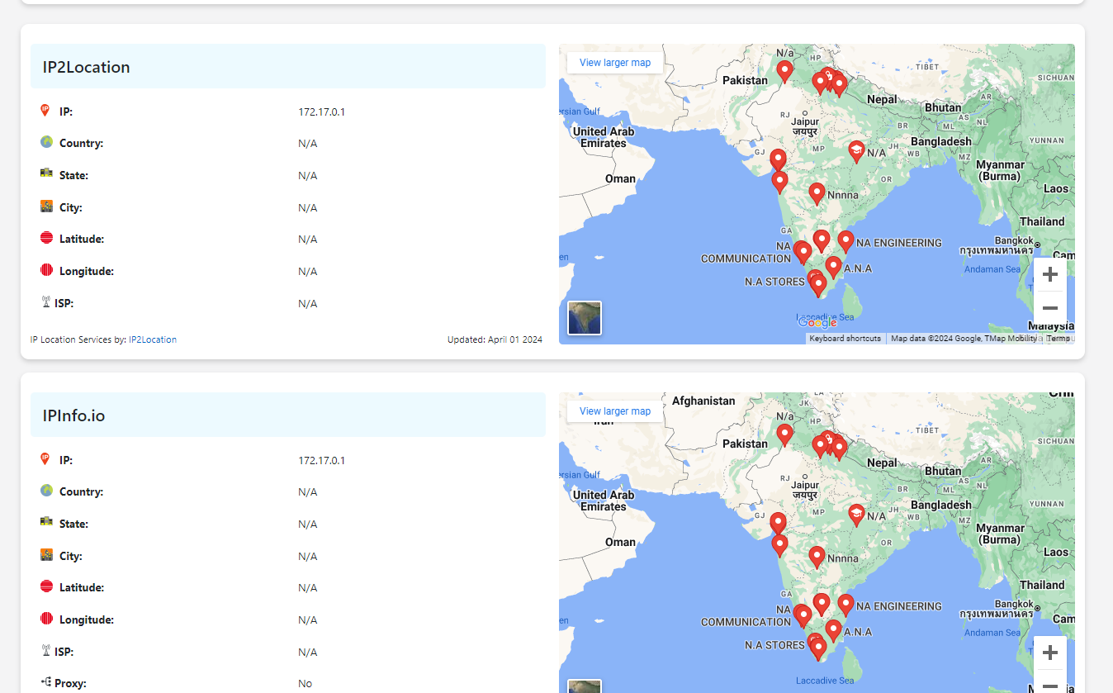
Osnit frame work on the tools for dns information gathering

Slide 7
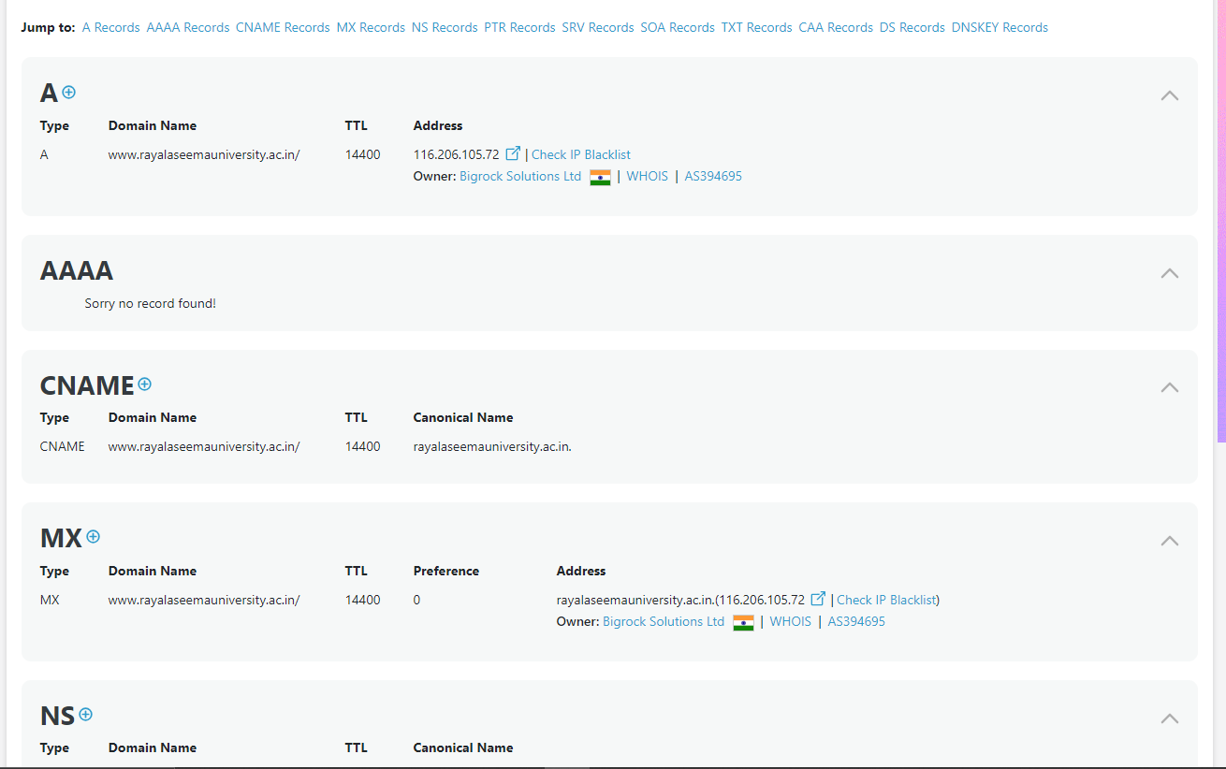
Dns for maping source for ruk web site details analysis

Slide 8
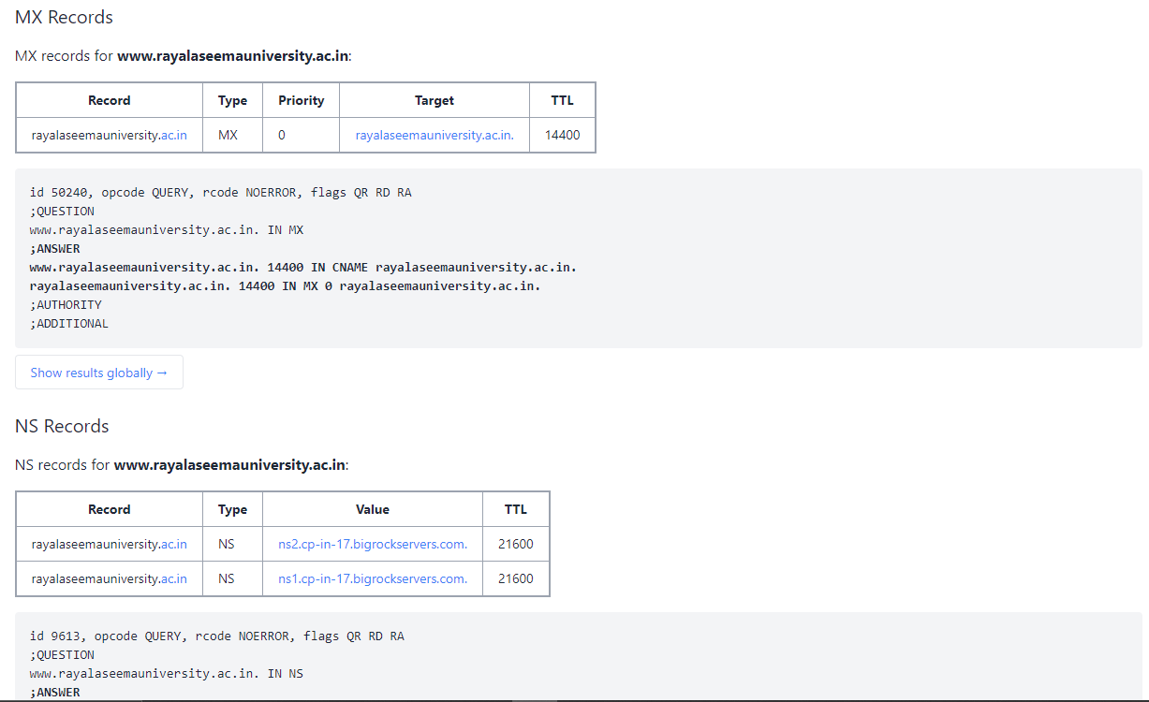
Ruk website into report for domain

Slide 9
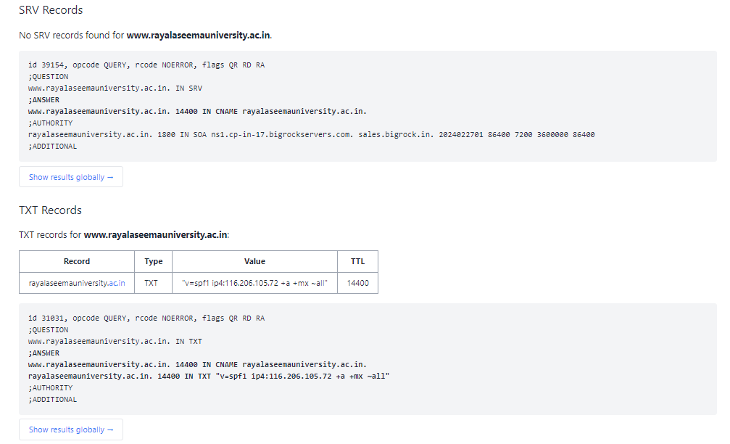
Srn details and txt records on the ruk website

Slide 10
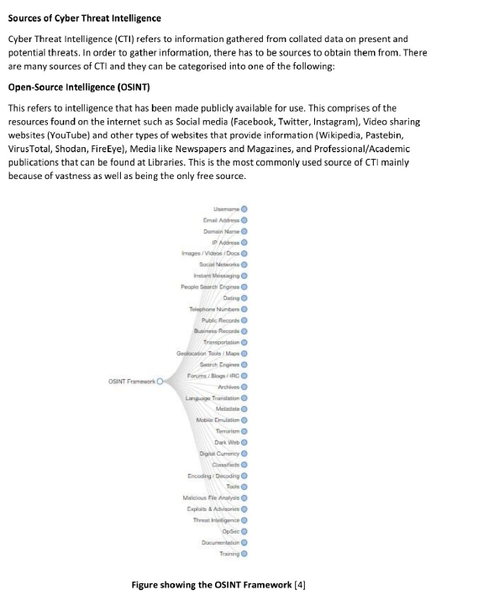
Osnit frame work anaylsis for key points

Slide 11
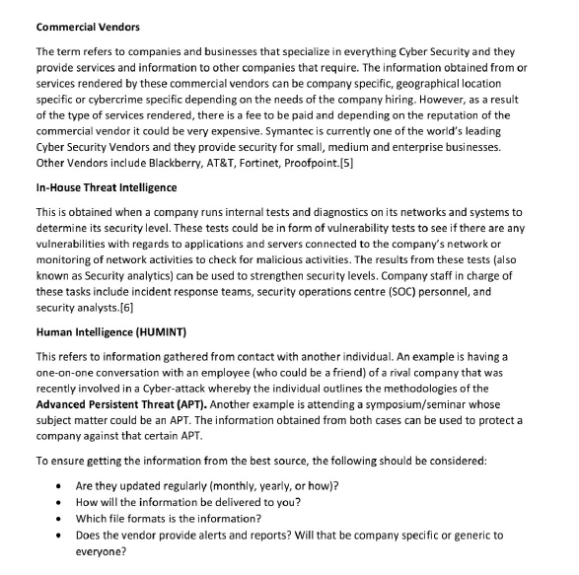
Information source intelligence

Slide 12
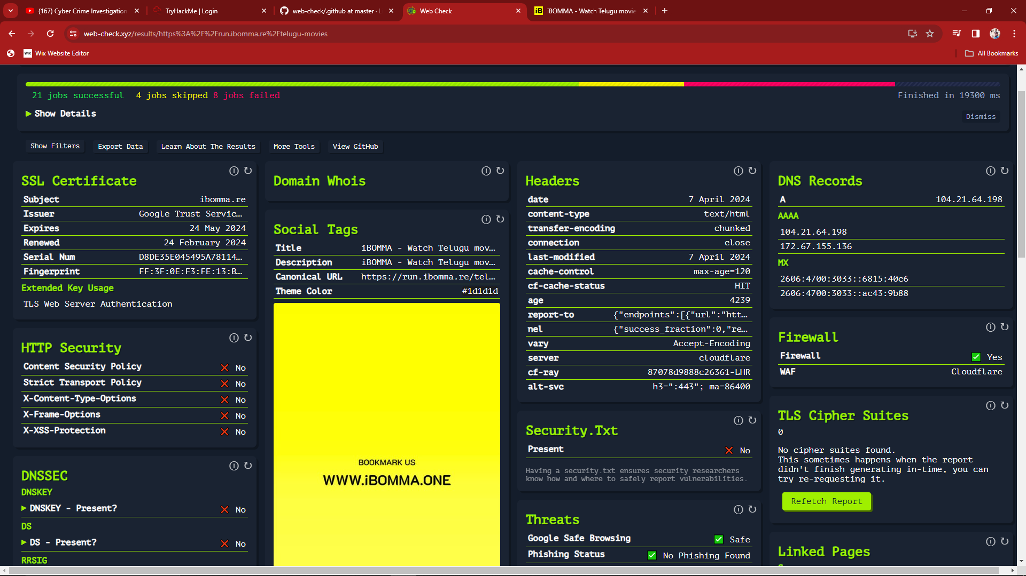
Ibomma web site details anaylsis for webcheker.site in them analysis

Slide 13
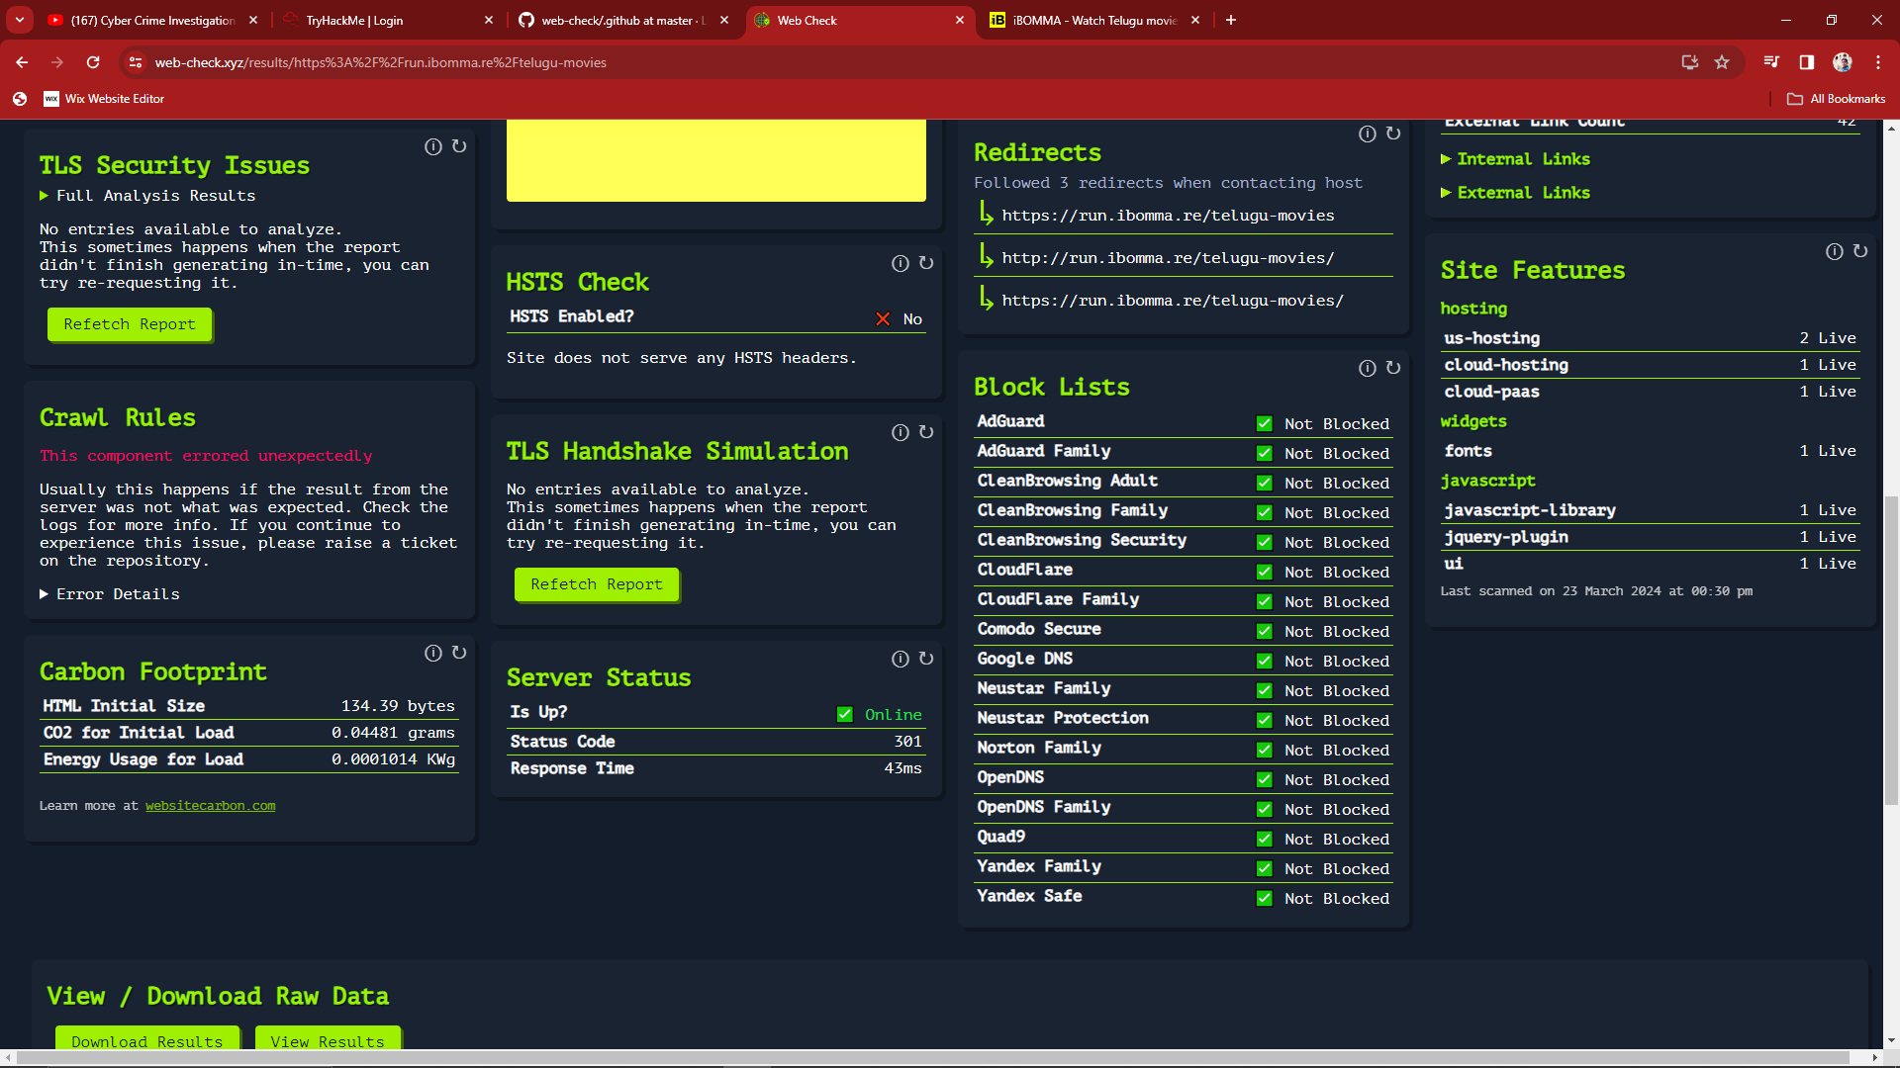
Tl s security for issuses site feture

Slide 14
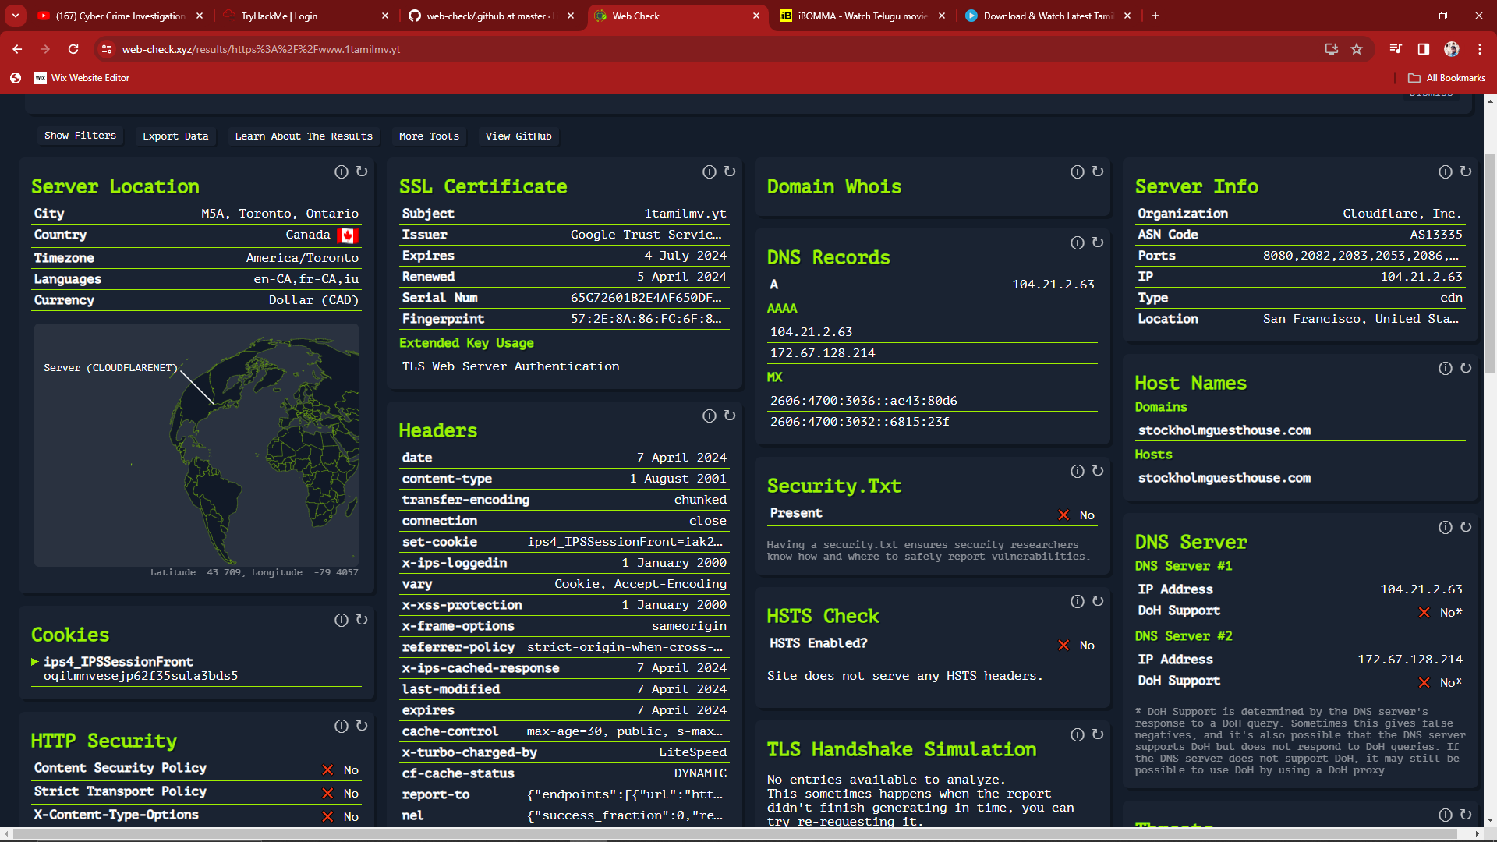
Website into webcheker 1tamil.mv after anaylsis and dns servers

Slide 15
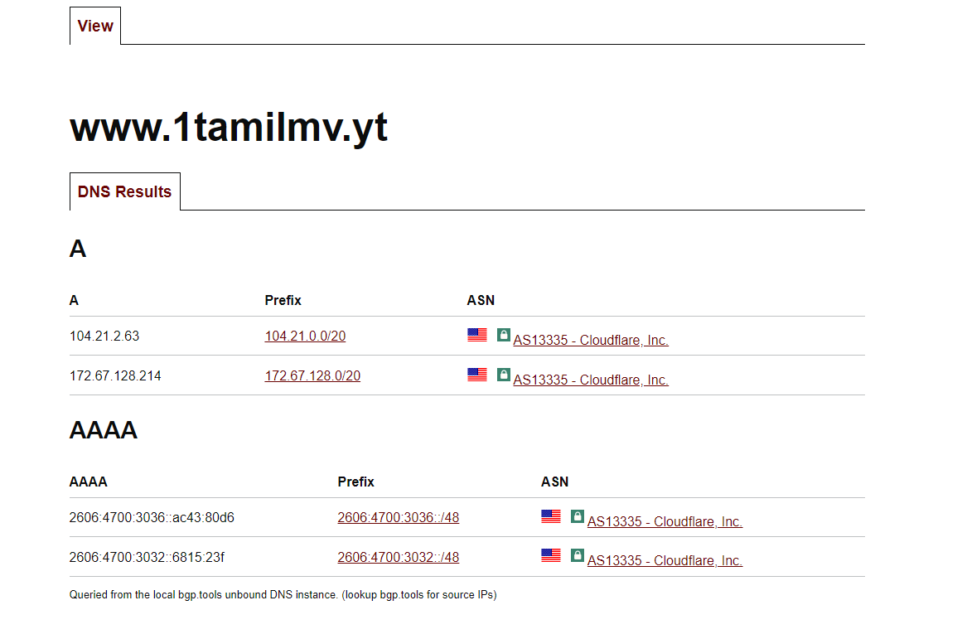
Dns to domain ip adderss for on tamil.mv scaning report

